Slide 1
Halting Functions for Tree-Like Structures
CS 5010 Program Design Paradigms “Bootcamp”
Lesson 6.6
© Mitchell Wand, 2016
This work is licensed under a Creative Commons Attribution-NonCommercial 4.0 International License.

Slide 2
Learning Outcomes
At the end of this lesson, the student should be able to
Explain the definition of a halting measure for mutually-recursive functions
Write a halting measure for functions on S-expressions that use the template.

Slide 3
Let's review halting measures for list functions
Let's look at the template for list data and the definition of a halting measure.
Then we'll look at the call graph for a list function and see what the halting measure looks like on the call graph.

Slide 4
Review: Template for List data
;; list-fn : ListOfX -> ??
(define (list-fn lst)
(cond
[(empty? lst) ...]
[else (... (first lst)
(list-fn (rest lst)))]))
Remember the template for list data

Slide 5
Review: Halting Measure
Definition: a halting measure for a particular function is an integer-valued quantity that can't be less than zero, and which decreases at each recursive call in that function.

Slide 6
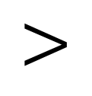
Another picture: the call graph
list-fn calls itself. The halting measure (the size of the argument) decreases at each call.
list-fn
$$<$$
A computation can go around this cycle only finitely many times, because the halting measure is always a non-negative integer.
halting measure decreases

Slide 7
Now let's do it again for SoS and LoSS
An S-expression of Strings (SoS) is either
-- a String
-- a List of SoS's (LoSS)
A List of SoS's (LoSS) is either
-- empty
-- (cons SoS LoSS)
Here's the data definition again

Slide 8
This is mutual recursion
SoS LoSS
defined in terms of
defined in terms of

Slide 9
And here's the template
;; sos-fn : SoS -> ??
(define (sos-fn s)
(cond
[(string? s) ...]
[else (loss-fn s)]))
;; loss-fn : LoSS -> ??
(define (loss-fn los)
(cond
[(empty? los) ...]
[else (... (sos-fn (first los))
(loss-fn (rest los)))]))

Slide 10
This is mutual recursion
sos-fn loss-fn
defined in terms of
defined in terms of

Slide 11
What's a good halting measure for this pair of functions?
We claim that the size of the SoS or LoSS is a halting measure for this pair of functions.
What do we mean by size here? Ans: the number of cons cells
But wait, you say: when sos-fn calls loss-fn, this size of the argument doesn't decrease
Let's look at this more closely by examining the call graph

Slide 12
Let's draw the call graph in more detail
sos-fn calls loss-fn
sos-fn and loss-fn may call other functions, but none of those functions ever call sos-fn or loss-fn
sos-fn
loss-fn
loss-fn calls sos-fn and loss-fn

Slide 13
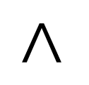
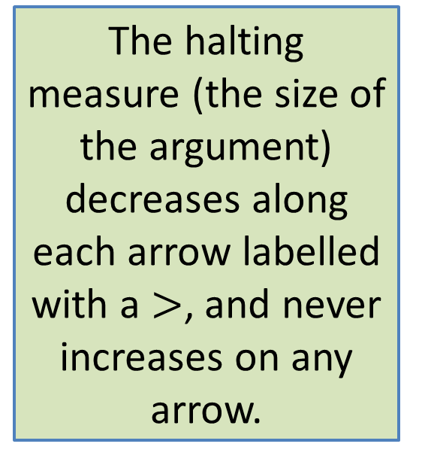

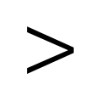
Where does the halting measure decrease?
So the halting measure decreases around every cycle in this graph. Since the size of the argument is a non-negative integer, a computation can make only finitely many calls in this graph.
The halting measure (the size of the argument) decreases along each arrow labelled with a $>$, and never increases on any arrow.
sos-fn
$$=$$
$$<$$
loss-fn
$$<$$

Slide 14
Refined Definition of a Halting Measure
Definition: a halting measure for a particular function is an integer-valued quantity that can't be less than zero, and which decreases around every cycle in the call graph.
In general, you can't just look at a single function– you have to trace the call graph.
For functions that follow the template, the size of the argument is almost always a halting measure.

Slide 15
A more subtle example Descendant Trees
(define-struct person (name children))
;; A Person is a
;; (make-person String Persons)
;; A Persons is one of
;; -- empty
;; -- (cons Person Persons)
Two mutually recursive data definitions

Slide 16
What's a good way to measure the size of one of these?
Ans: number of nodes in the tree, where a node is either a make-person or a cons.
This is the standard way of measuring the size of a structure.

Slide 17
Example of a pair of functions on this data definition
;; Person -> Persons
;; STRATEGY: Use template for Person on p
(define (person-descendants p)
(append
(person-children p)
(persons-descendants (person-children p))))
;; Persons -> Persons
;; STRATEGY: Use HOF map followed by foldr
(define (persons-descendants ps)
(foldr append empty
(map person-descendants ps)))
With HOFs, the finding the call graph may take more care. Here's an example.

Slide 18
The call graph for this pair of functions
person-descendants
via map
persons-descendants

Slide 19


The halting measure decreases on both arrows
person-descendants
(person-children p) is
smaller than p
$$<$$
$$<$$
persons-descendants
All we need is for the halting measure to decrease on every cycle, so it would be ok if one of these >'s was an =. Just so long as none of the calls increases the halting measure!
map calls person-descendants on
each element of ps; the elements of ps
are always smaller than ps

Slide 20
Summary
You should now be able to:
Explain the definition of a halting measure for mutually-recursive functions
Write a halting measure for functions on S-expressions and other mutually-recursive data types that use the template.

Slide 21
Next Steps
If you have questions about this lesson, ask them in class or on the Discussion Board
Do Problem Set 6

